Slide 1
Decorators

Slide 2
Decorators
Prerequisites
Namespace and Variable Scope
LEGB Rule
Closure
Decorators?
Use of decorators?
How are they used?
Type of decorators?

Slide 3
Name Space and Variable Scope
Namespace (sometimes also called a context) is a naming system for making names unique to avoid ambiguity.
A Python Namespace is an efficient system where each and every object in Python has a unique name. Every package, module, class, function and method in Python occupies a namespace in which variable names are set.
Namespaces in Python are implemented as Python dictionaries, this means it is a mapping from names (keys) to objects (values).
A namespace gets created automatically when a module or package starts execution. Hence, to create a namespace, all you have to do is call a function/ object or import a module/package.
Notes:
https://www.youtube.com/watch?v=60BhDMIm5vk
https://www.toppr.com/guides/python-guide/tutorials/python-introduction/namespace/python-namespace-and-scope-of-a-variable/#:~:text=Namespaces%20are%20collections%20of%20different,)%2C%20global%2C%20and%20local.

Slide 4
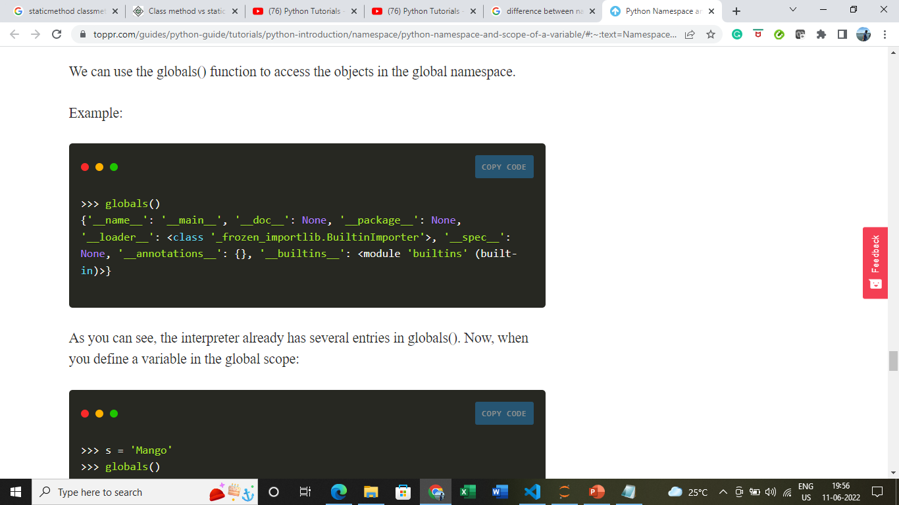
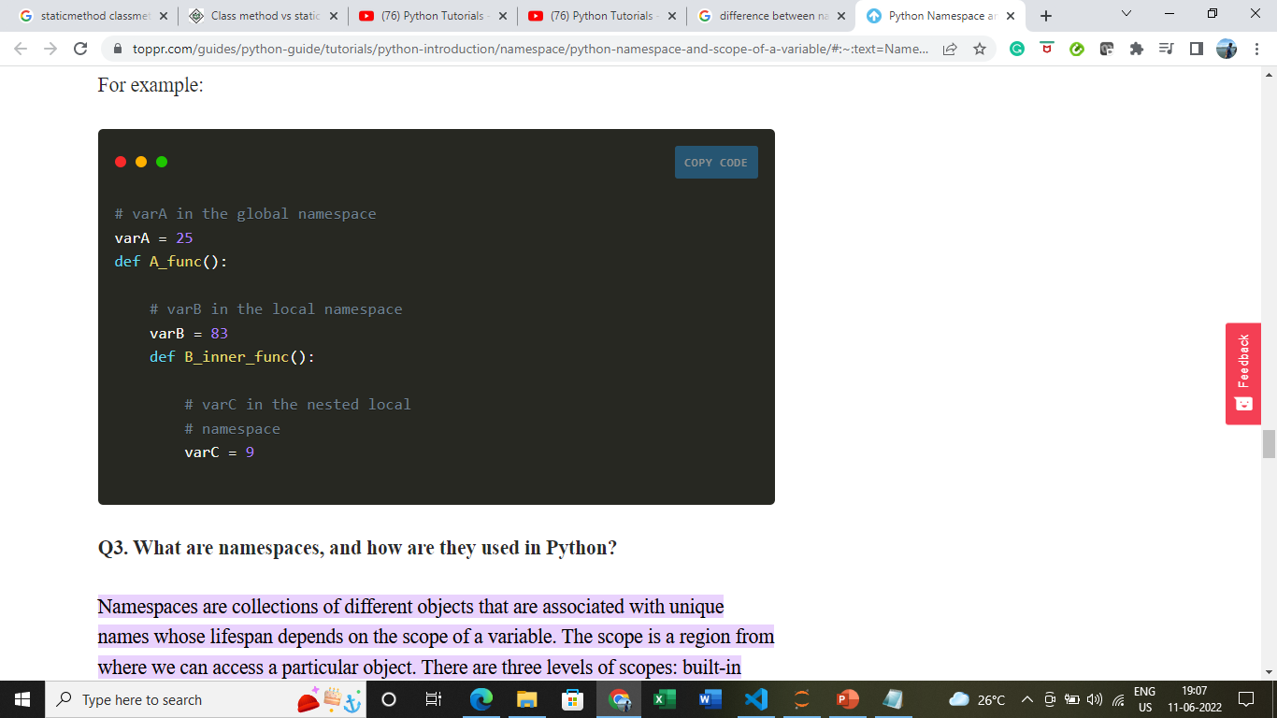
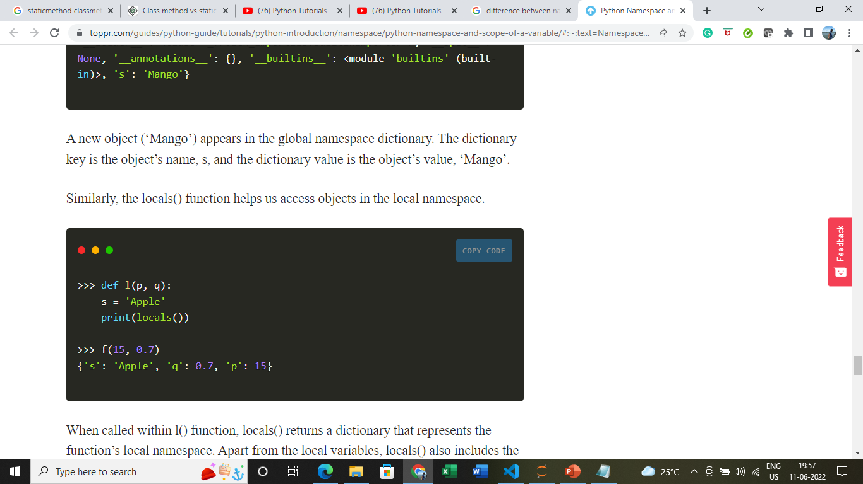
Name Space and Variable Scope
Types of Python Namespace
Built-in namespace
Global namespace
Local namespace
Notes:
https://www.youtube.com/watch?v=60BhDMIm5vk
https://www.toppr.com/guides/python-guide/tutorials/python-introduction/namespace/python-namespace-and-scope-of-a-variable/#:~:text=Namespaces%20are%20collections%20of%20different,)%2C%20global%2C%20and%20local.

Slide 5
Name Space and Variable Scope
Variable scope refers to the visibility of variables. In other words, which parts of your program can see or use it.
Python uses the location of the name assignment or definition to associate it with a particular scope. In other words, where you assign or define a name in your code determines the scope or visibility of that name.
Scope refers to the coding region from where we can access a particular object directly (without any prefix).
We cannot access any specific object from anywhere in the code. The access has to be allowed by the scope of the object.
Notes:
https://www.youtube.com/watch?v=60BhDMIm5vk
https://www.toppr.com/guides/python-guide/tutorials/python-introduction/namespace/python-namespace-and-scope-of-a-variable/#:~:text=Namespaces%20are%20collections%20of%20different,)%2C%20global%2C%20and%20local.
https://realpython.com/python-scope-legb-rule/#:~:text=The%20LEGB%20rule%20is%20a,the%20first%20occurrence%20of%20it.

Slide 6
Name Space and Variable Scope
In a program, you will find at least three nested scopes of:
The function that contains the local names.
The module that contains the global names
Scope of the built-in names (outermost).
When we make a reference inside a function, the interpreter first looks for the name inside the local namespace, then the global namespace and finally the built-in namespace.
Notes:
https://www.youtube.com/watch?v=60BhDMIm5vk
https://www.toppr.com/guides/python-guide/tutorials/python-introduction/namespace/python-namespace-and-scope-of-a-variable/#:~:text=Namespaces%20are%20collections%20of%20different,)%2C%20global%2C%20and%20local.
https://realpython.com/python-scope-legb-rule/#:~:text=The%20LEGB%20rule%20is%20a,the%20first%20occurrence%20of%20it.

Slide 7
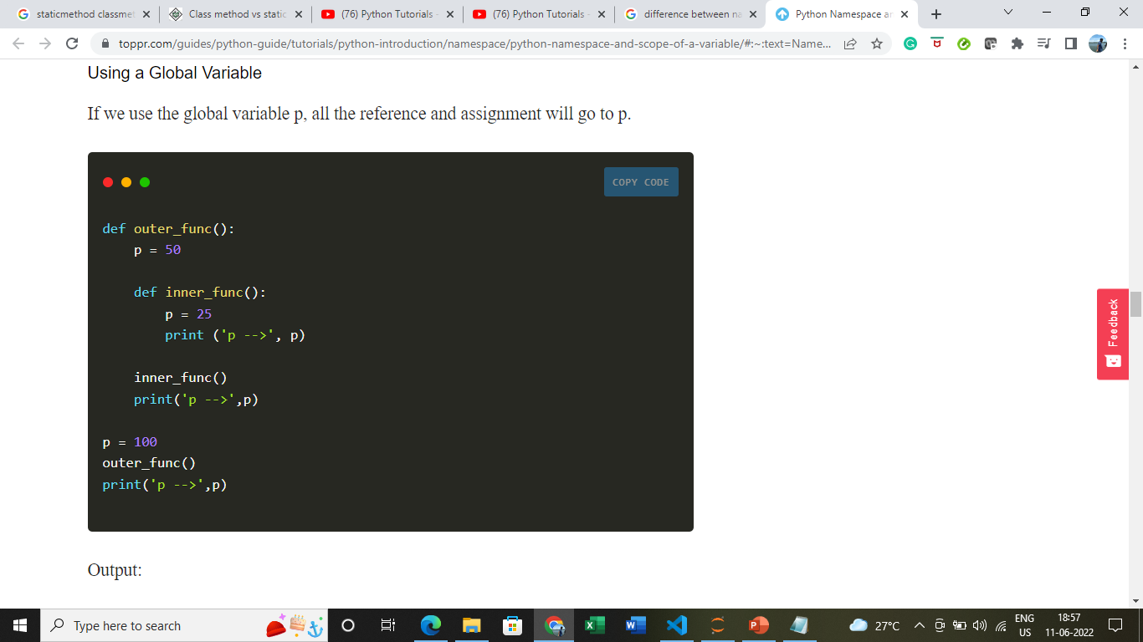
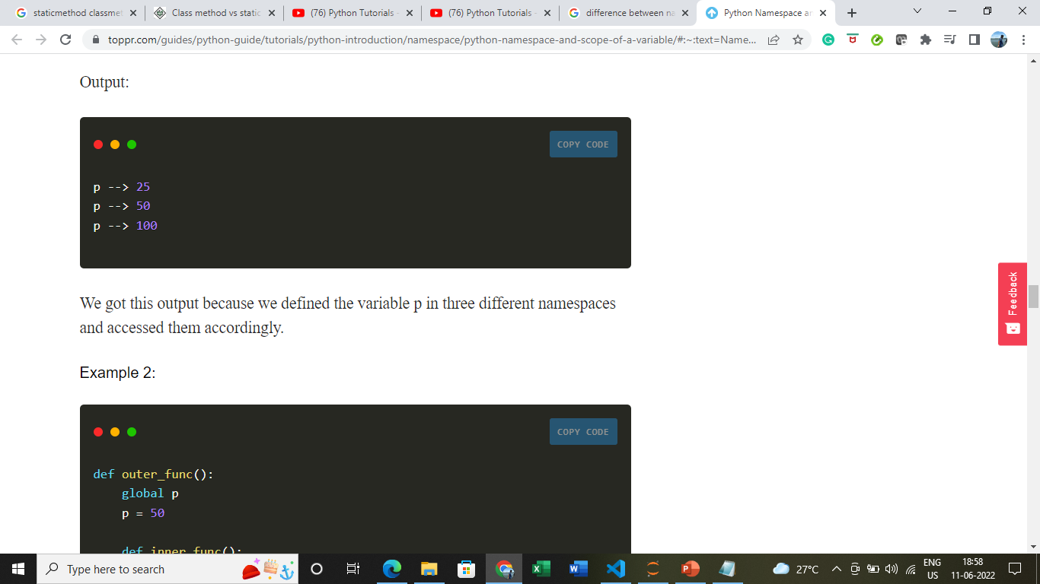
Name Space and Variable Scope
The concept of scope is closely related to the concept of the namespace.
As you’ve learned so far, a Python scope determines where in your program a name is visible.
Python scopes are implemented as dictionaries that map names to objects. These dictionaries are commonly called namespaces.
These are the concrete mechanisms that Python uses to store names.
They’re stored in a special attribute called .__dict__.
Notes:
https://www.youtube.com/watch?v=60BhDMIm5vk
https://www.toppr.com/guides/python-guide/tutorials/python-introduction/namespace/python-namespace-and-scope-of-a-variable/#:~:text=Namespaces%20are%20collections%20of%20different,)%2C%20global%2C%20and%20local.
https://www.youtube.com/watch?v=hKoQhK3AS_I

Slide 8
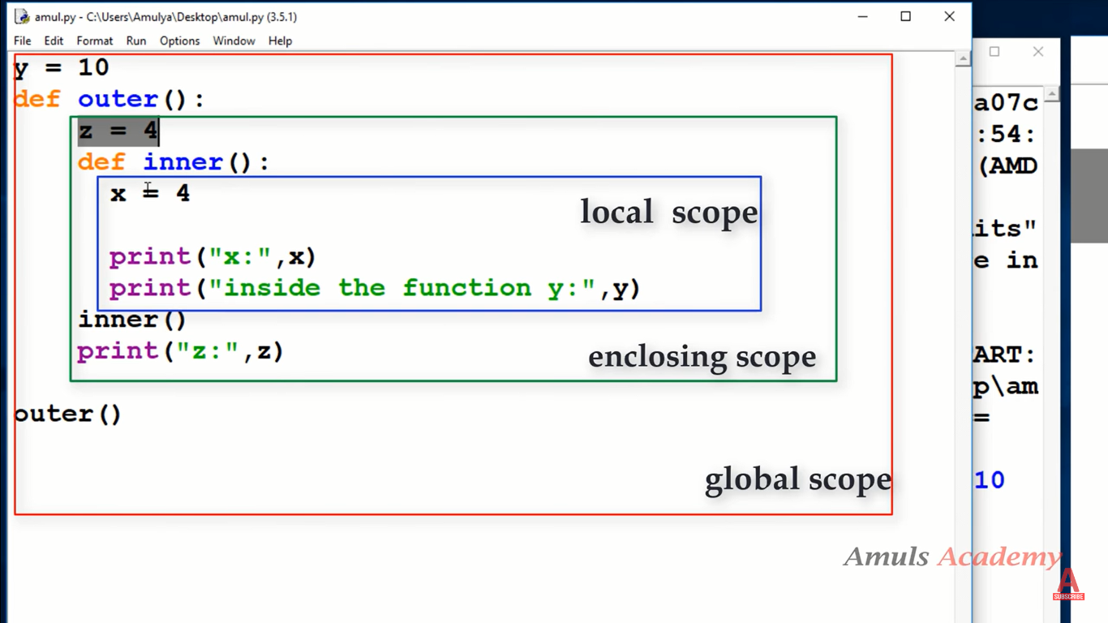
LEGB Rule
The LEGB rule is a kind of name lookup procedure, which determines the order in which Python looks up names.
LEGB stand for Local, Enclosing, Global, and Built-in scopes
Following the LEGB rule, you’ll look up number in the following places:
Inside inner_func(): This is the local scope, but number doesn’t exist there.
Inside outer_func(): This is the enclosing scope, but number isn’t defined there either.
In the module scope: This is the global scope, and you find number there, so you can print number to the screen.
If number isn’t defined inside the global scope, then Python continues the search by looking at the built-in scope.
Notes:
https://www.youtube.com/watch?v=hKoQhK3AS_I
https://realpython.com/python-scope-legb-rule/#:~:text=The%20LEGB%20rule%20is%20a,the%20first%20occurrence%20of%20it.
https://www.knowledgehut.com/blog/data-science/python-scopes

Slide 9
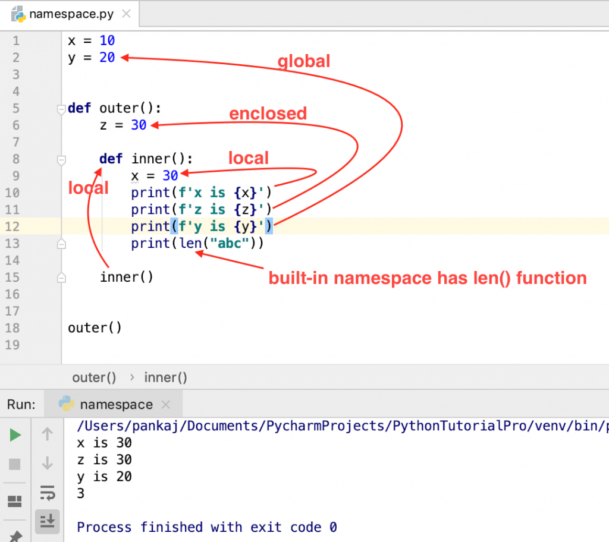
LEGB Rule
Local (or function) scope is the code block or body of any Python function or lambda expression. This Python scope contains the names that you define inside the function. These names will only be visible from the code of the function. It’s created at function call, not at function definition, so you’ll have as many different local scopes as function calls. This is true even if you call the same function multiple times, or recursively. Each call will result in a new local scope being created. When the function returns, the local scope is destroyed and the names are forgotten.
Enclosing (or nonlocal) scope is a special scope that only exists for nested functions. If the local scope is an inner or nested function, then the enclosing scope is the scope of the outer or enclosing function. This scope contains the names that you define in the enclosing function. The names in the enclosing scope are visible from the code of the inner and enclosing functions. Names that you define in the enclosing Python scope are commonly known as nonlocal names. From inside inner (), this scope is neither the global scope nor the local scope.
Notes:
https://realpython.com/python-scope-legb-rule/#:~:text=The%20LEGB%20rule%20is%20a,the%20first%20occurrence%20of%20it.
https://www.knowledgehut.com/blog/data-science/python-scopes

Slide 10
LEGB Rule
Global (or module) scope is the top-most scope in a Python program, script, or module. This Python scope contains all of the names that you define at the top level of a program or a module. Names in this Python scope are visible from everywhere in your code.
Built-in scope is a special Python scope that’s created or loaded whenever you run a script or open an interactive session. This scope contains names such as keywords, functions, exceptions, and other attributes that are built into Python. Or When the variable or object is not found in local, global, or enclosing scope, then Python starts looking for it in the built-in scope. Built-in scopes are one of the widest scopes that cover all the reserved keywords. These are easy to call anywhere in the program prior to using them, without the need to define them.
Whenever you try to access a name that isn’t defined in any Python scope, you’ll get a NameError. The error message will include the name that couldn’t be found.
Notes:
https://realpython.com/python-scope-legb-rule/#:~:text=The%20LEGB%20rule%20is%20a,the%20first%20occurrence%20of%20it.
https://www.knowledgehut.com/blog/data-science/python-scopes

Slide 11
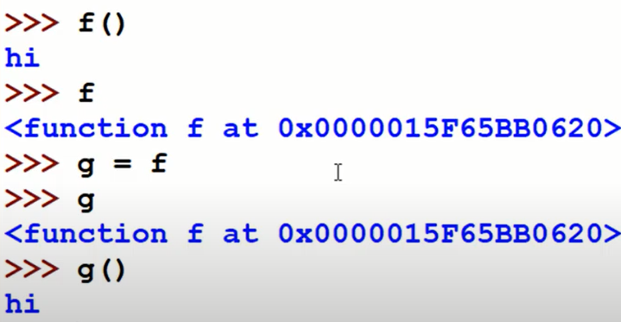
Closure
Functions are first class object in python. We can assign a function to a variable.
If we don’t use “ ()” then it will not call function instead it will provide reference i.e. memory address of function object. This address value is equal to hex(id(f))
Notes:
https://www.youtube.com/watch?v=tvWRhMkUcoU
https://www.google.com/imgres?imgurl=https%3A%2F%2Fwww.pythontutorial.net%2Fwp-content%2Fuploads%2F2020%2F11%2FPython-Closure-Example.png&imgrefurl=https%3A%2F%2Fwww.pythontutorial.net%2Fadvanced-python%2Fpython-closures%2F&tbnid=rH-ew_StZIqjmM&vet=12ahUKEwjF_MC4-6X4AhUHyKACHb3jAhQQMygAegUIARC1AQ..i&docid=u5mLnCASP2oufM&w=391&h=158&q=closure%20in%20python&ved=2ahUKEwjF_MC4-6X4AhUHyKACHb3jAhQQMygAegUIARC1AQ

Slide 12
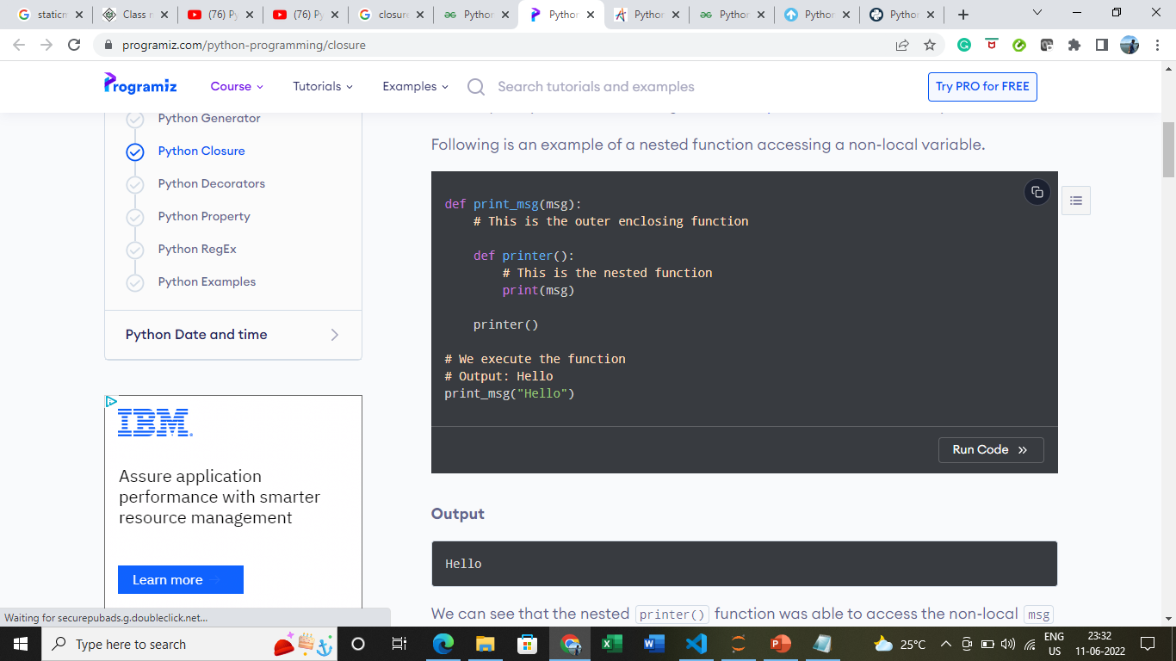
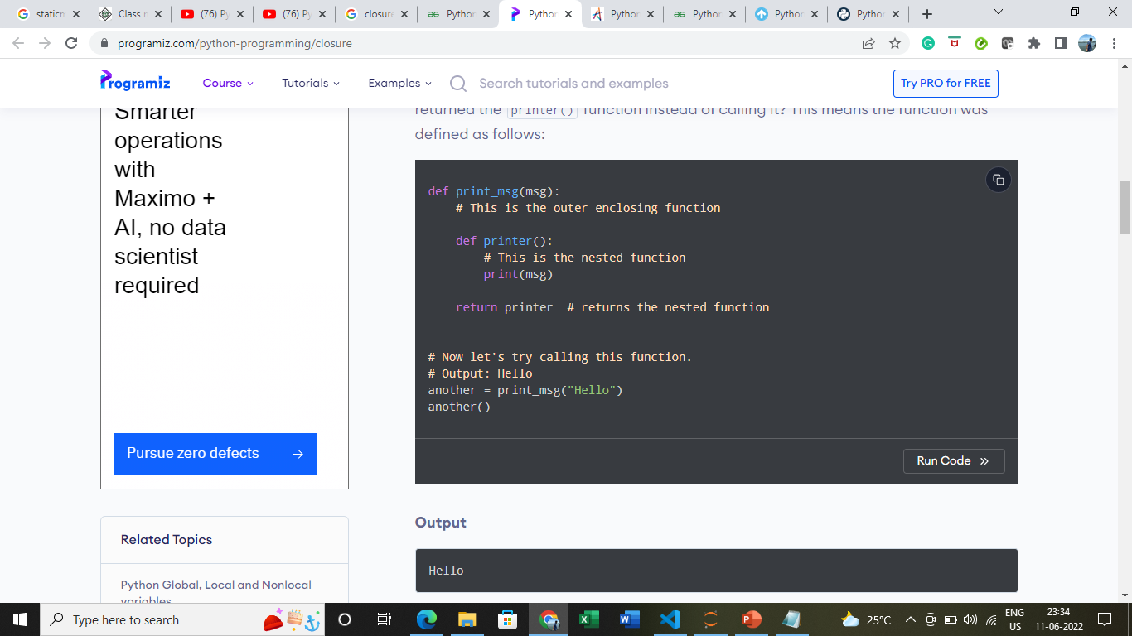
Closure
The print_msg() function was called with the string "Hello" and the returned function was bound to the name another. On calling another(), the message was still remembered although we had already finished executing the print_msg() function. Even if we delete print_msg() still we will have value (hidden) from enclosing scope
This technique by which some data ("Hello in this case) gets attached to the code is called closure in Python OR Function object that remembers value in the enclosing scope even if they are not memory are called closure.
This value in the enclosing scope is remembered even when the variable goes out of scope or the function itself is removed from the current namespace.
what would happen if the last line of the function print_msg() returned the printer() function instead of calling it? i.e. we are returning reference “printer”
Notes:
https://www.programiz.com/python-programming/closure
https://www.youtube.com/watch?v=tvWRhMkUcoU
https://www.google.com/imgres?imgurl=https%3A%2F%2Fwww.pythontutorial.net%2Fwp-content%2Fuploads%2F2020%2F11%2FPython-Closure-Example.png&imgrefurl=https%3A%2F%2Fwww.pythontutorial.net%2Fadvanced-python%2Fpython-closures%2F&tbnid=rH-ew_StZIqjmM&vet=12ahUKEwjF_MC4-6X4AhUHyKACHb3jAhQQMygAegUIARC1AQ..i&docid=u5mLnCASP2oufM&w=391&h=158&q=closure%20in%20python&ved=2ahUKEwjF_MC4-6X4AhUHyKACHb3jAhQQMygAegUIARC1AQ

Slide 13
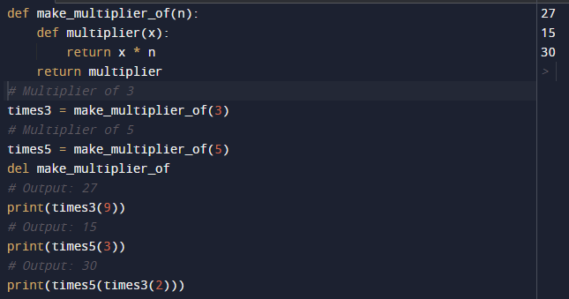
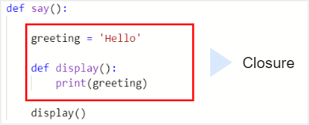
Closure
Closures can avoid the use of global values and provides some form of data hiding. It can also provide an object oriented solution to the problem.
As closures are used as callback functions, they provide some sort of data hiding. This helps us to reduce the use of global variables.
When we have few functions in our code, closures prove to be an efficient way. But if we need to have many functions, then go for class (OOP).
times3 and times5 are closure functions.
Python Decorators make an extensive use of closures as well.
Notes:
https://www.programiz.com/python-programming/closure
https://www.geeksforgeeks.org/python-closures/
https://www.google.com/imgres?imgurl=https%3A%2F%2Fwww.pythontutorial.net%2Fwp-content%2Fuploads%2F2020%2F11%2FPython-Closure-Example.png&imgrefurl=https%3A%2F%2Fwww.pythontutorial.net%2Fadvanced-python%2Fpython-closures%2F&tbnid=rH-ew_StZIqjmM&vet=12ahUKEwjF_MC4-6X4AhUHyKACHb3jAhQQMygAegUIARC1AQ..i&docid=u5mLnCASP2oufM&w=391&h=158&q=closure%20in%20python&ved=2ahUKEwjF_MC4-6X4AhUHyKACHb3jAhQQMygAegUIARC1AQ

Slide 14
Closure
The criteria that must be met to create closure in Python are summarized in the following points.
We must have a nested function (function inside a function).
The nested function must refer to a value defined in the enclosing function.
The enclosing function must return the nested function.
Benefits of using Closure
Avoid defining values in global scope. ( we have stored values from enclosing scope )
Data hiding
Implementation in decorators
Notes:
https://www.programiz.com/python-programming/closure
https://www.geeksforgeeks.org/python-closures/
https://www.google.com/imgres?imgurl=https%3A%2F%2Fwww.pythontutorial.net%2Fwp-content%2Fuploads%2F2020%2F11%2FPython-Closure-Example.png&imgrefurl=https%3A%2F%2Fwww.pythontutorial.net%2Fadvanced-python%2Fpython-closures%2F&tbnid=rH-ew_StZIqjmM&vet=12ahUKEwjF_MC4-6X4AhUHyKACHb3jAhQQMygAegUIARC1AQ..i&docid=u5mLnCASP2oufM&w=391&h=158&q=closure%20in%20python&ved=2ahUKEwjF_MC4-6X4AhUHyKACHb3jAhQQMygAegUIARC1AQ

Slide 15
Decorator
In Python, functions are first class objects which means that functions in Python can be used or passed as arguments.
Properties of first class functions:
A function is an instance of the Object type.
You can store the function in a variable.
You can pass the function as a parameter to another function.
You can return the function from a function.
You can store them in data structures such as hash tables, lists
Notes:
https://www.geeksforgeeks.org/decorators-in-python/

Slide 16
Decorator
Type of decorators:
User Defined Decorators
Built In Decorators:
@Property decorator
@classmethod decorator
@staticmethod decorator
Notes:
https://www.geeksforgeeks.org/decorators-in-python/

Slide 17
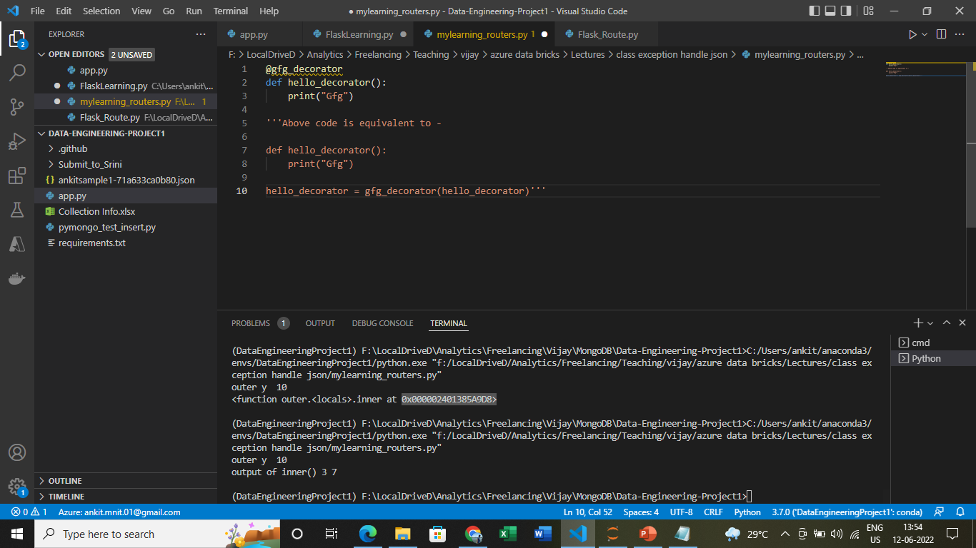
Decorator
Decorators are a very powerful and useful tool in Python since it allows programmers to modify the behaviour of a function or class.
Decorators allow us to wrap another function in order to extend the behaviour of the wrapped function, without permanently modifying it
A decorator is a function that takes another function as input, extends its behavior, and returns a new function as output.
Syntax for Decorator:
Notes:
https://www.geeksforgeeks.org/decorators-in-python/

Slide 18
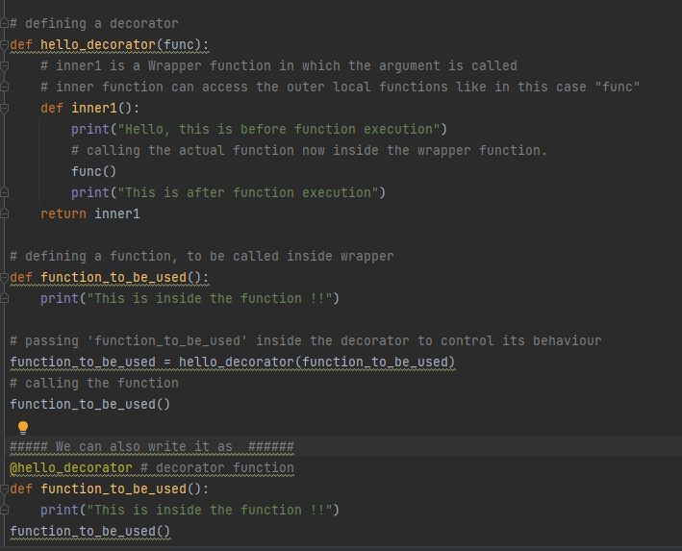
Decorator
Notes:
https://www.geeksforgeeks.org/decorators-in-python/

Slide 19
Decorator
A function can be a decorating function¶
if it return a function
if it takes a function as argument
if it add/modify functionality of a function
We can :
1. use multiple decorators on single function
2. use parameter in decorator function
3. Use single decorator on multiple function : general decorators
Notes:
https://www.geeksforgeeks.org/decorators-in-python/
https://www.youtube.com/watch?v=LBhKYNFzWMw

Slide 20
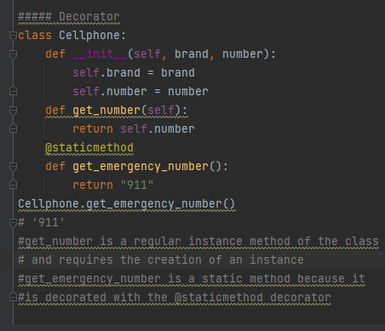
Built in decorators
@staticmethod : It does not require the creation of an instance of a class. For Python, it means that the first argument of a static method is not self, but a regular positional or keyword argument. Also, a static method can have no arguments at all.
A static method is also a method that is bound to the class and not the object of the class.
A static method can’t access or modify the class state.
It is present in a class because it makes sense for the method to be present in class.
Static method knows nothing about class
Notes:
https://betterprogramming.pub/how-to-use-the-magical-staticmethod-classmethod-and-property-decorators-in-python-e42dd74e51e7

Slide 21
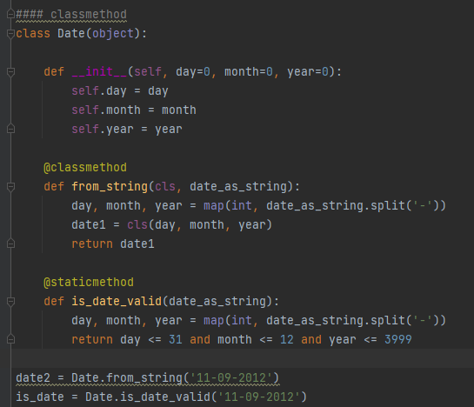
Builtin decorators Decorators
@classmethod
created with the @classmethod decorator. A class method receives the class as an implicit first argument (“cls”), just like an instance method receives the instance (“self”).
A class method is a method that is bound to the class and not the object of the class.
They have the access to the state of the class as it takes a class parameter that points to the class and not the object instance.
It can modify a class state that would apply across all the instances of the class. For example, it can modify a class variable that will be applicable to all the instances.
Notes:
https://betterprogramming.pub/how-to-use-the-magical-staticmethod-classmethod-and-property-decorators-in-python-e42dd74e51e7

Slide 22
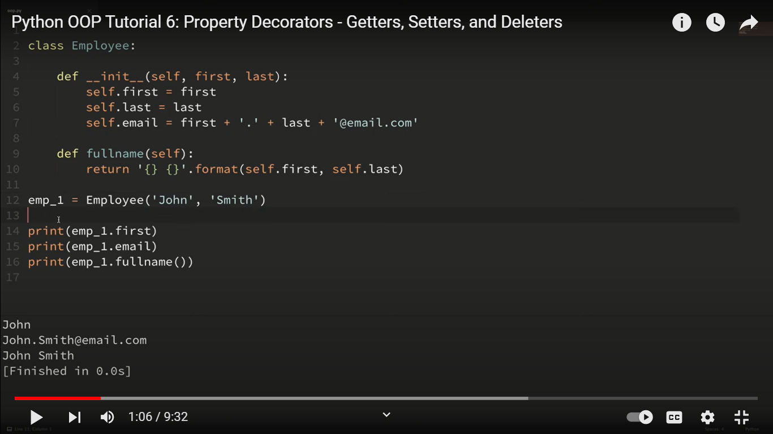
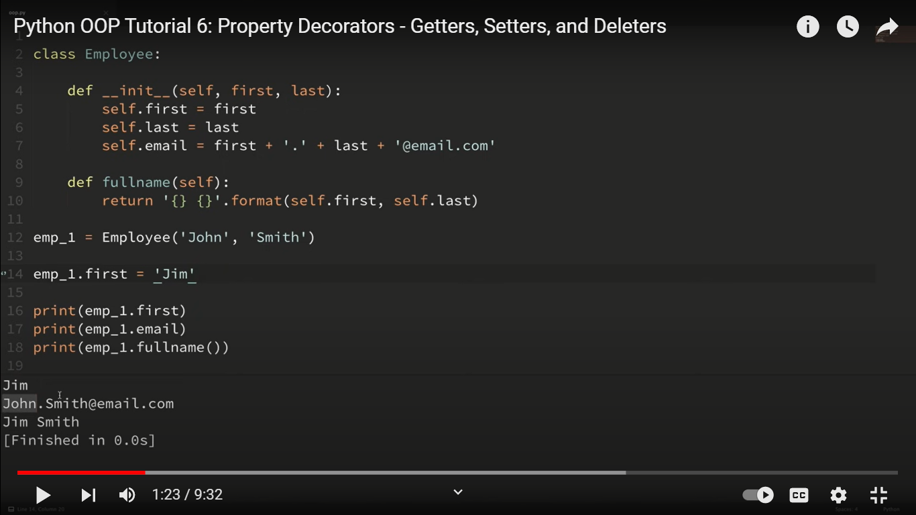
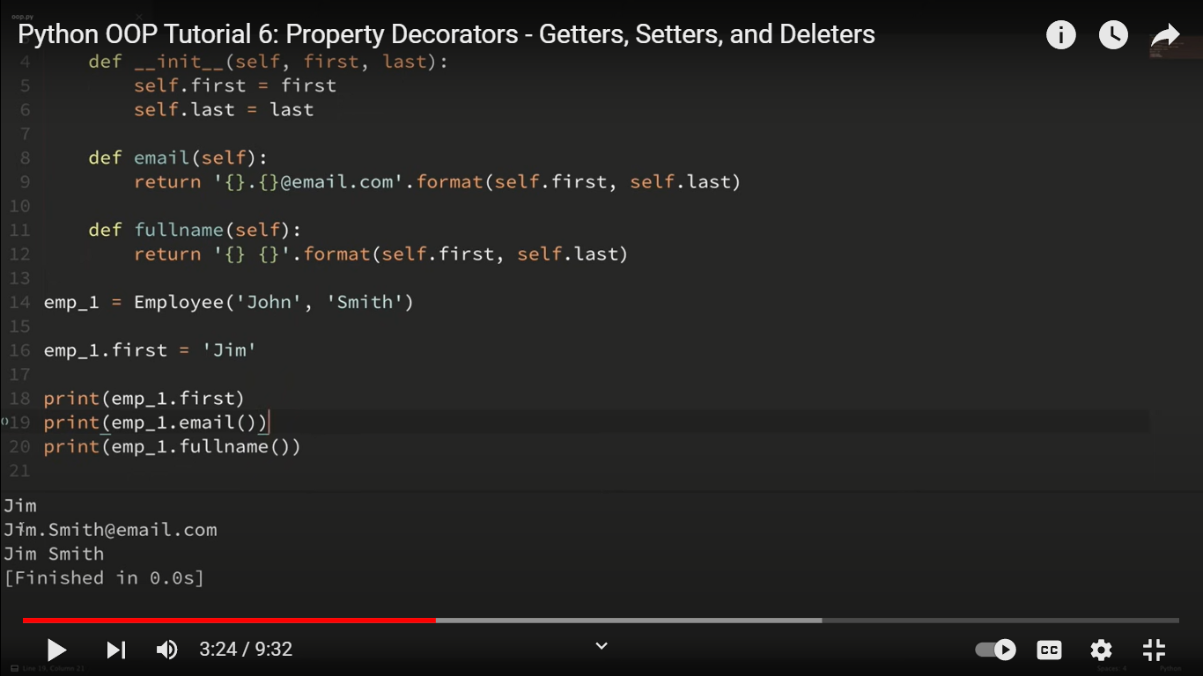
Builtin decorators Decorators
@property
It will allow us to use class method as attribute
Replace setter and getter method using property decorator
If I want to update output from email then Then there are two options :
Even if I set emp_1.first=‘jim’
Its email attribute did not change
But fullname() provides updated output
Notes:
https://betterprogramming.pub/how-to-use-the-magical-staticmethod-classmethod-and-property-decorators-in-python-e42dd74e51e7
https://github.com/CoreyMSchafer/code_snippets/tree/master/Object-Oriented
https://www.youtube.com/watch?v=jCzT9XFZ5bw

Slide 23
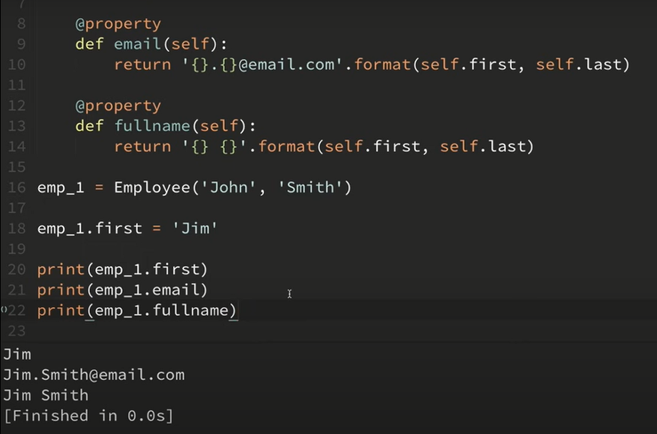
Builtin decorators Decorators
Option1 :
Use email as method rather
Than attribute but cons is
We need to update our
Code in all following section.
e.g. print(emp_1.email)
To print(emp_1.email())
Option2 :
Use Property decorator.
And email can be used as an
Attribute rather than a method.
In fact other methods can
Also be decorated by this decorator
Notes:
https://betterprogramming.pub/how-to-use-the-magical-staticmethod-classmethod-and-property-decorators-in-python-e42dd74e51e7
https://github.com/CoreyMSchafer/code_snippets/tree/master/Object-Oriented
https://www.youtube.com/watch?v=jCzT9XFZ5bw

Slide 24
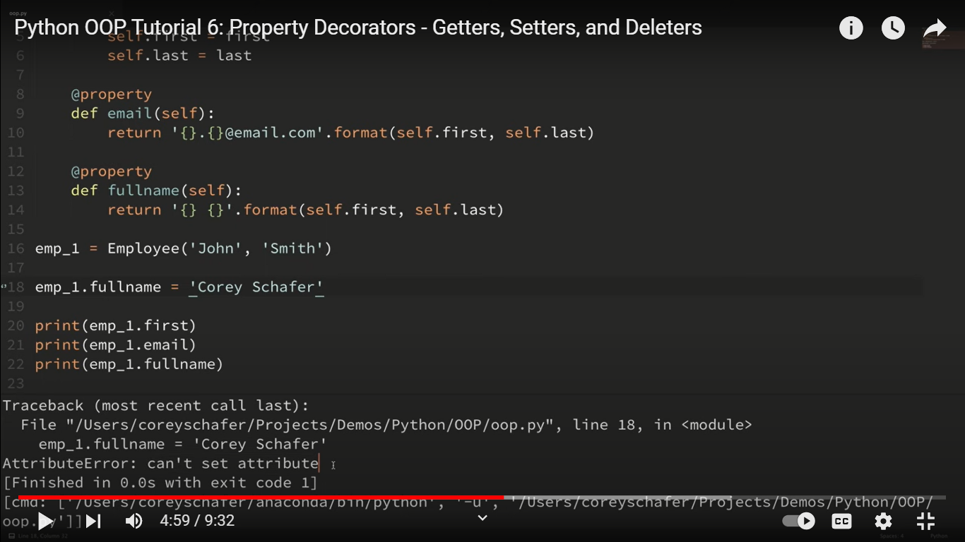
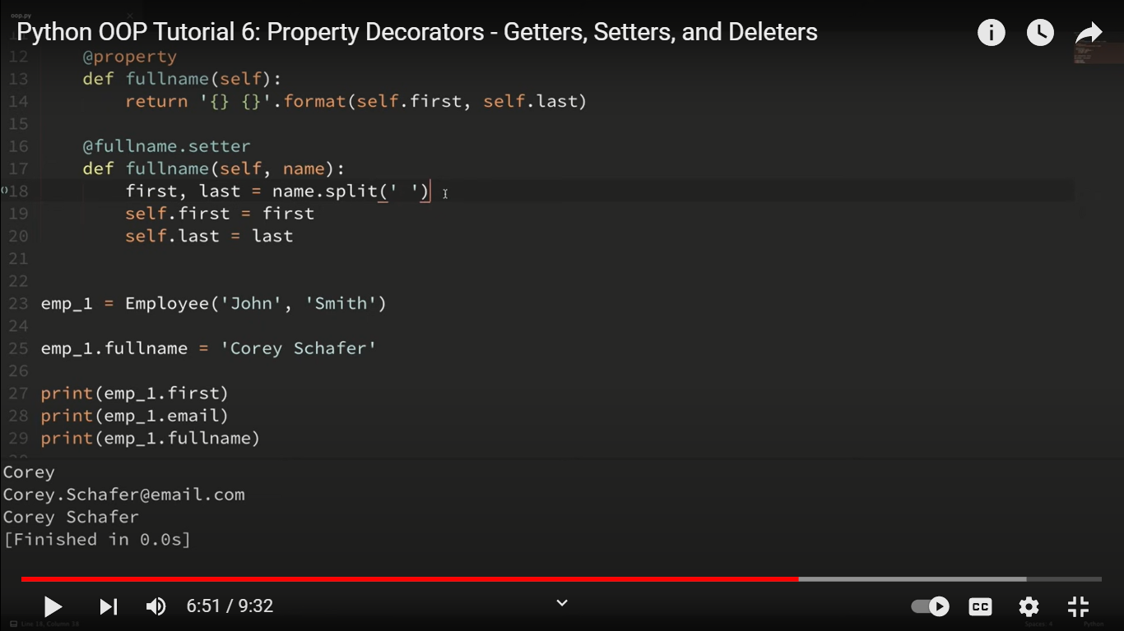
Builtin decorators Decorators
What if I want to set fullname?
It will throw an
Attributeerror : can’t set attribute.
Solution :Use setter
Notes:
https://www.youtube.com/watch?v=jCzT9XFZ5bw

Slide 25
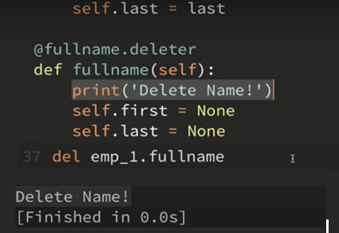
Builtin decorators Decorators
Use deleter
If we want to delete any attribute
Notes:
https://www.youtube.com/watch?v=jCzT9XFZ5bw

